Slide 1
Industrial Training Project
on
“Online Food Delivery System”
Group Members
Gautam Kumar (20BCS9807)
Md Adnan Hussain (20BCS9812)
Naina Baghel (20BCS9819)
Kumar Suyash (20BCS9842)

Slide 2
What’s the Basic Idea behind the project
Many of us were visiting countless website these days some of them were very user-friendly but on the other side some of them are little complicated too, So what’s the possible solution we came up with is a Hassel free and clean but Informative Web Page.
Here with the help of HTML,CSS and Java Script we make it possible. Some of the Code We’ll see ahead.
This project is designed so as to be used by customers to Order Food Online without rushing to restaurant which consumes a lot of time and energy.

Slide 3
It is a system through which customers can view available food, place an order and can view profile, menu, contact us, gallery etc. The advancement in Information Technology and internet penetration has greatly enhanced various business processes and communication between companies (services provider) and their customers. This application takes information from the customers through filling their details in a form. This automated system facilitates customer and provides to fill up the details according to their requirements. It includes type of food they want to order and their address. The purpose of this system is to develop a web site for the people who can place an order along with requirement from any part of the world.

Slide 4
Now the point is How we can demonstrate our Idea ?
For that we have taken a Restaurant Web page for Demonstrating our Idea. We used HTML for making the basic’s, CSS for beautification and Java Script for making the web page responsive.
The code that we made were visible in the next slide’s.

Slide 5
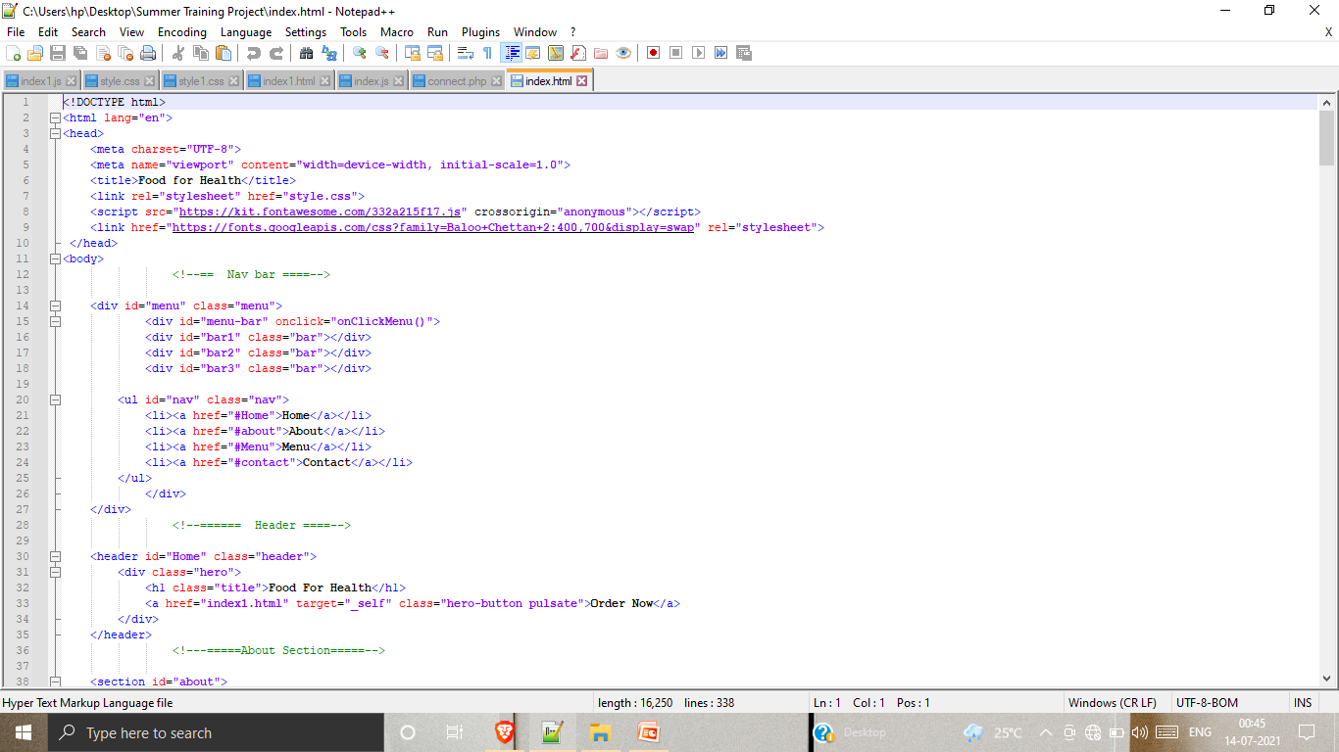
HTML- The skeleton of a Web Page

Slide 6
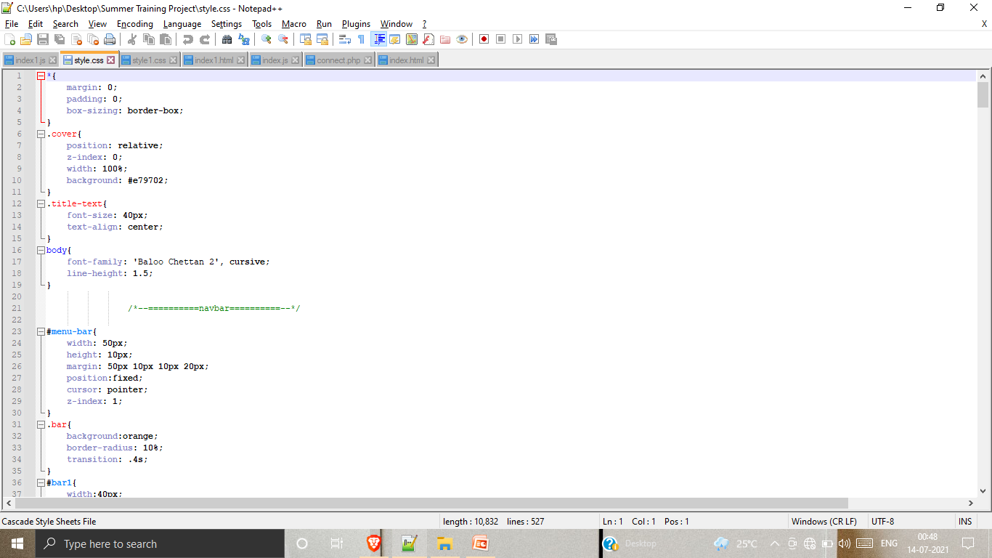
CSS-The Beautification

Slide 7
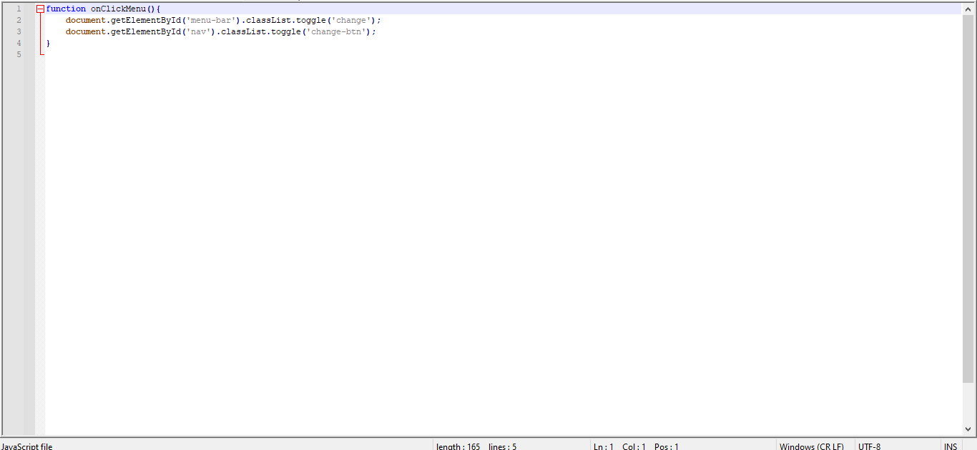
Java Script-The Brain

Slide 8

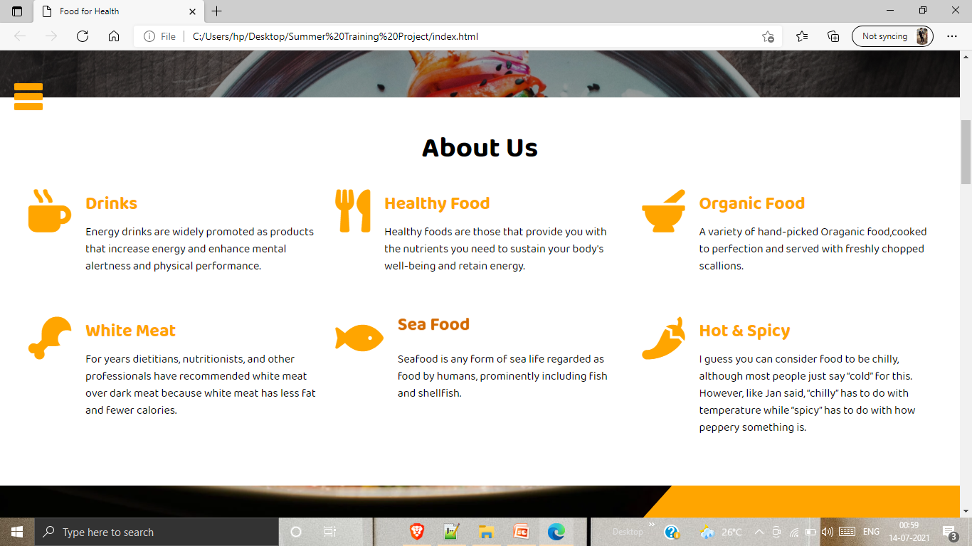
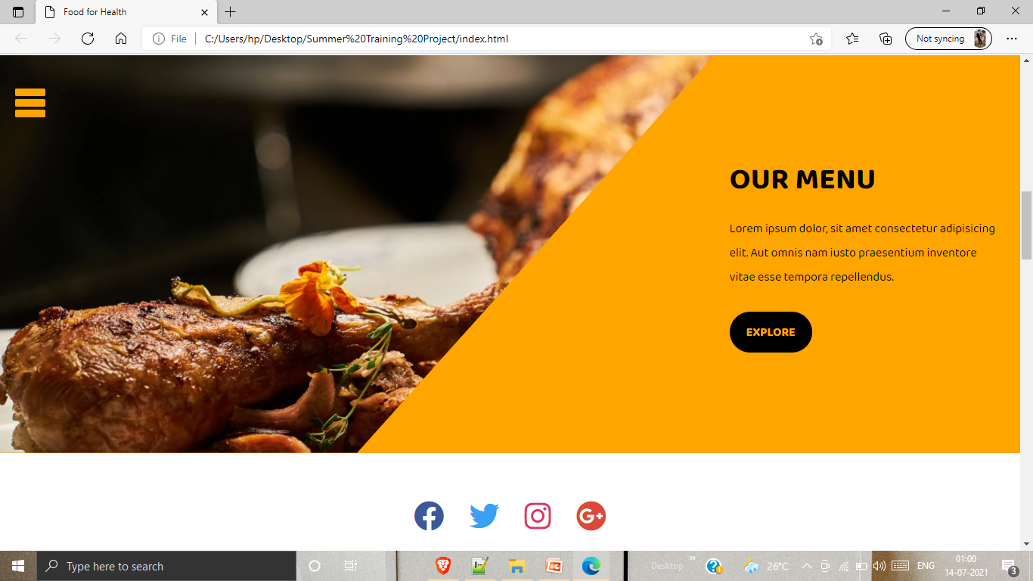
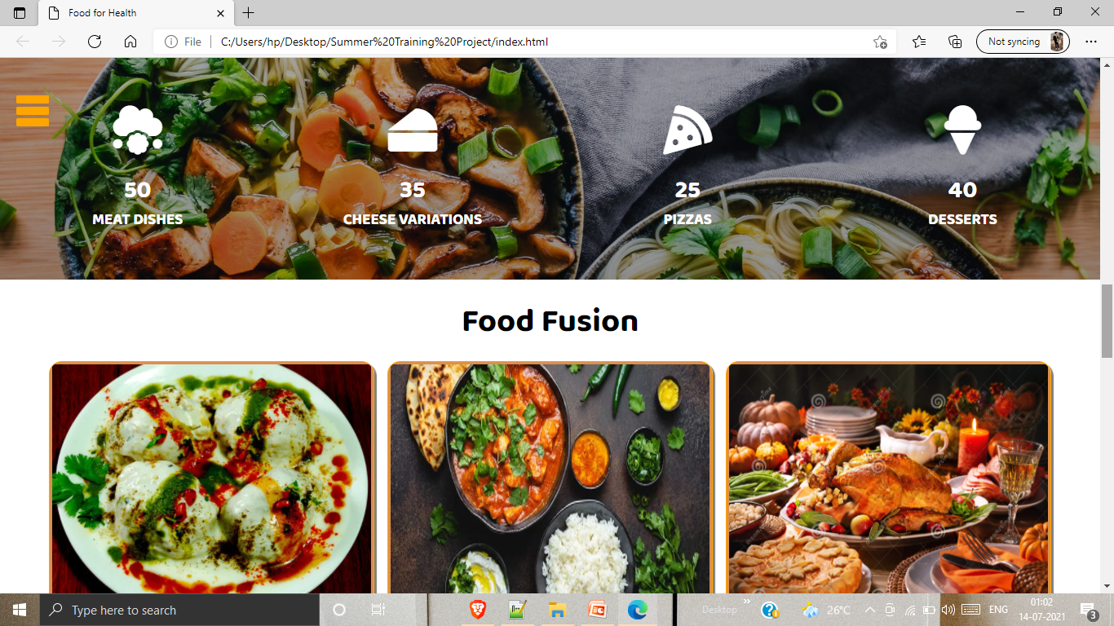
From the next slide’s we gone see the web page.

Slide 9
PHP
PHP is a general-purpose scripting language that is especially suited to web development. It was originally created by Danish-Canadian programmer Rasmus Lerdorf in 1994; the PHP reference implementation is now produced by The PHP Group. PHP originally stood for Personal Home Page, but it now stands for the recursive initialism PHP: Hypertext Preprocessor.

Slide 10
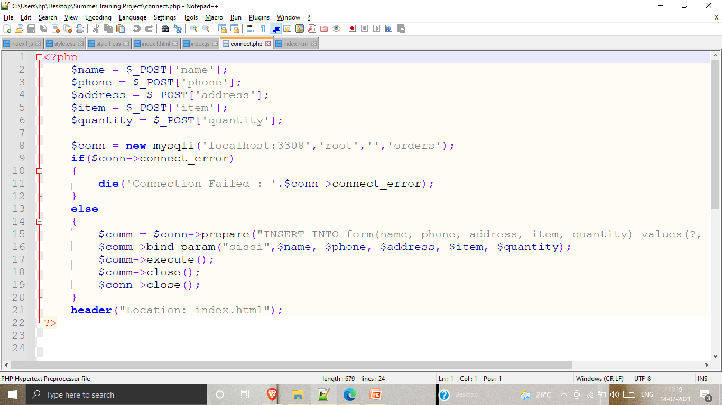
PHP CODE

Slide 11
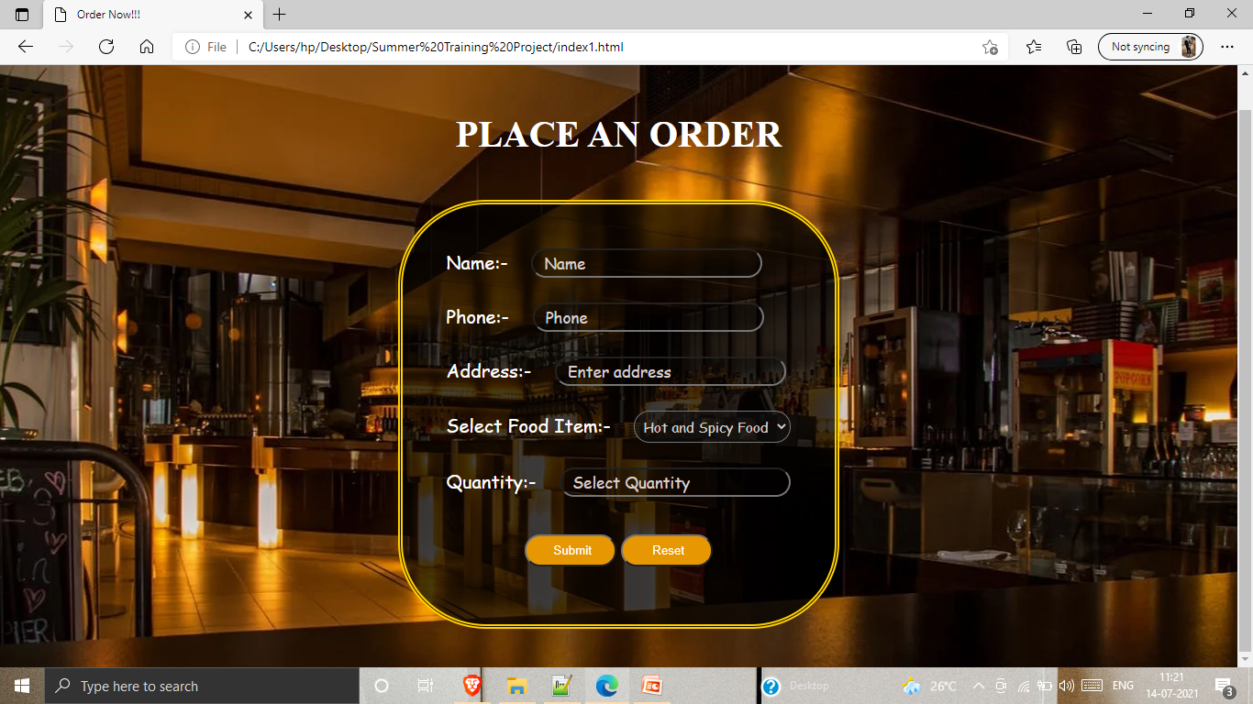
DELIVERY FORM

Slide 12
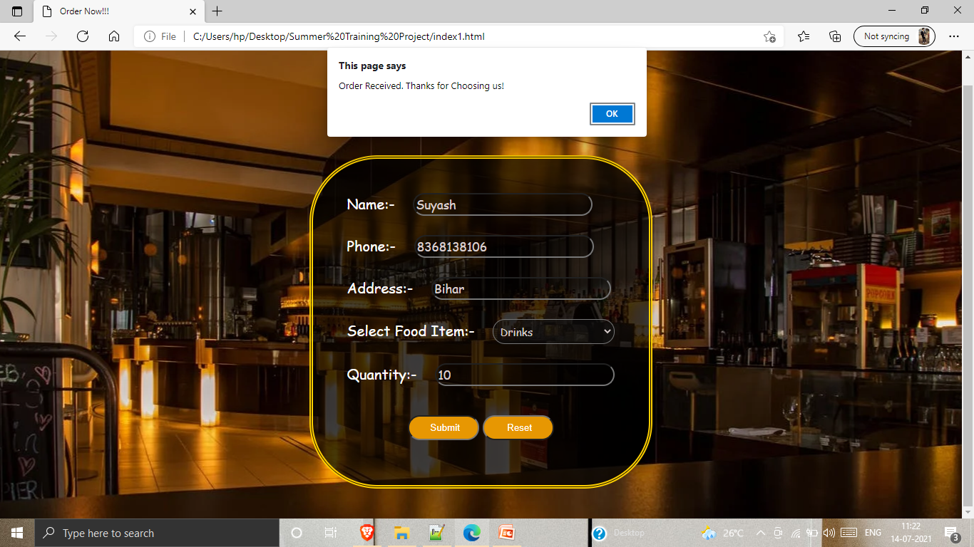
ORDER RECEIVED

